Slide 1
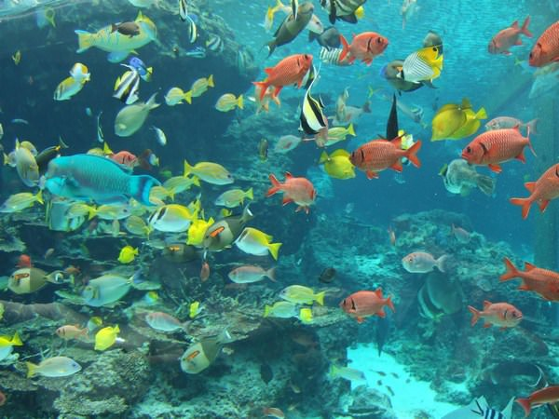

FishingPlace

Slide 2

Our team
Name | Role
Kirill Shabalyn | Team leader
Vladimir Ganzenko | Developer
Ann Minicheva | System Architect
Olga Kuznetsova | Business analyst

Slide 3

Problem analysis
We have chosen this project, because there are such actual problems:
Heavy search of a place for fishing
Bad quality places for fishing.

Slide 4
Problem analysis
How much audience can be interested in the product to become topical?
First, there is often a need to find a good place for fishing.
Secondly, for a large number of people in our country fishing is a favorite hobby.
And, finally, people of different age groups like fishing.

Slide 5
Problem analysis
Why this product could be interesting for you?
There are several reasons:
The ability to quickly find out the location of the place for fishing.
Reducing the time spent searching for a convenient way.
Simplicity, ease, efficiency and availability of product use by a large number of users.

Slide 6
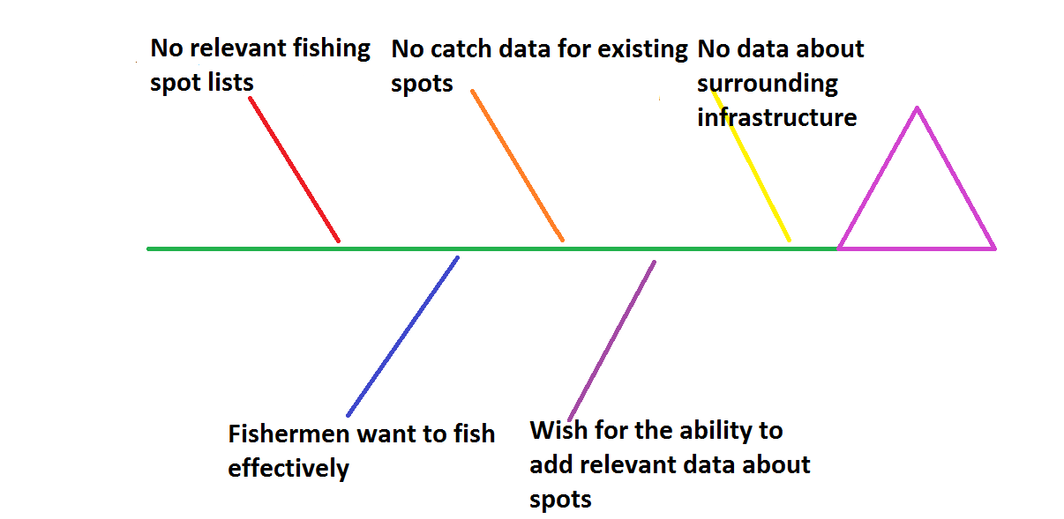
Fishbone Diagram

Slide 7
Pareto diagram

Slide 8
2. Understanding the needs of users

Slide 9
The functions of a product or system
Function | The ability to assess the places for fishing
Status | Included
Priority | High
Labor intensity | Average
Risk | Low
Stability | High

Slide 10
The functions of a product or system
Function | Registration via social networks
Status | Included
Priority | Average
Labor intensity | Low
Risk | Low
Stability | High

Slide 11
The functions of a product or system
Function | Selecting the range of the program
Status | Included
Priority | High
Labor intensity | Average
Risk | Low
Stability | Average

Slide 12
The functions of a product or system
Function | Vision of the price of booking a place for fishing
Status | Included
Priority | Average
Labor intensity | Average
Risk | Low
Stability | Average

Slide 13
The functions of a product or system
Function | Multilanguage
Status | Included
Priority | Average
Labor intensity | Low
Risk | Low
Stability | High

Slide 14
The functions of a product or system
Function | Determining the current location
Status | Included
Priority | High
Labor intensity | Average
Risk | Low
Stability | High

Slide 15
The functions of a product or system
Function | Providing information about stores with fishing gear
Status | Included
Priority | Avarage
Labor intensity | Average
Risk | Low
Stability | High

Slide 16
The functions of a product or system
Function | Providing information about nearby places to relax after fishing
Status | Included
Priority | Avarage
Labor intensity | Average
Risk | Low
Stability | High

Slide 17
The functions of a product or system
Function | Route to the place for fishing
Status | Included
Priority | High
Labor intensity | High
Risk | Low
Stability | High

Slide 18

Methods for identifying requirements
interviewing
questionnaire
meeting on requirements
storytelling
precedents
playing roles
creating prototypes

Slide 19
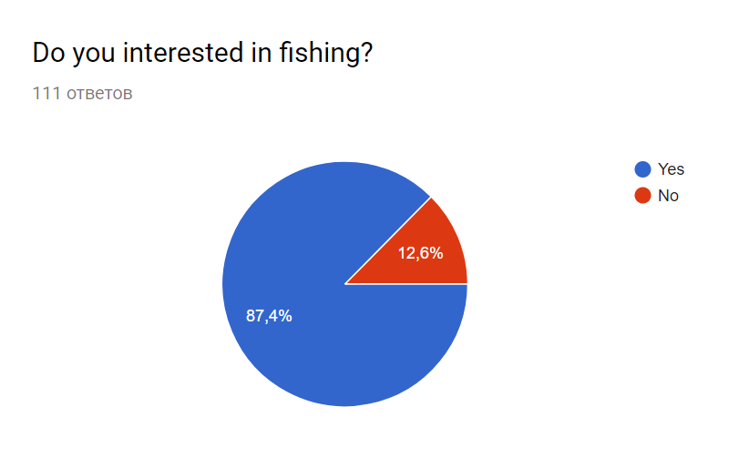
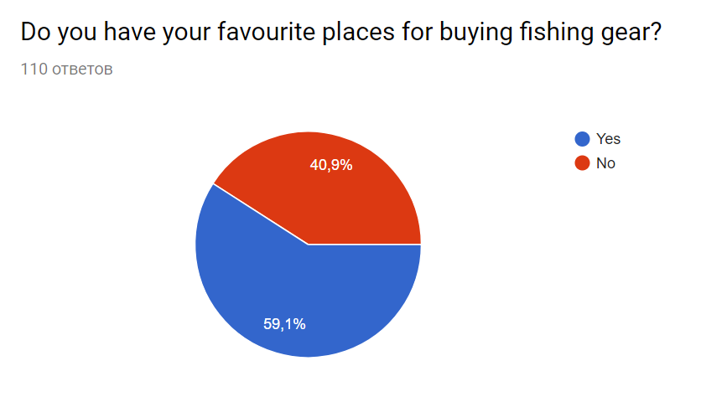
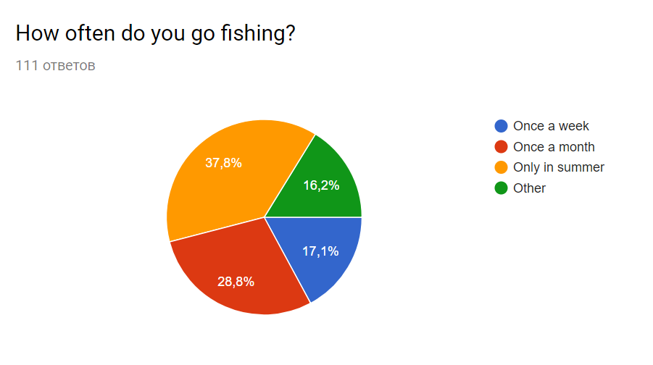
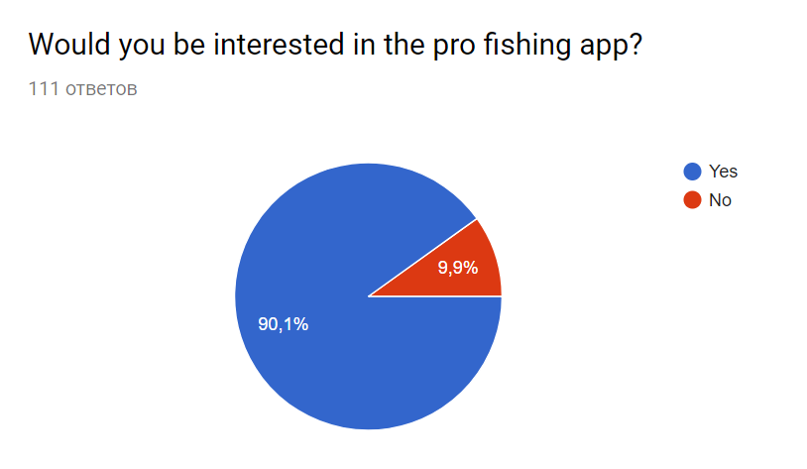
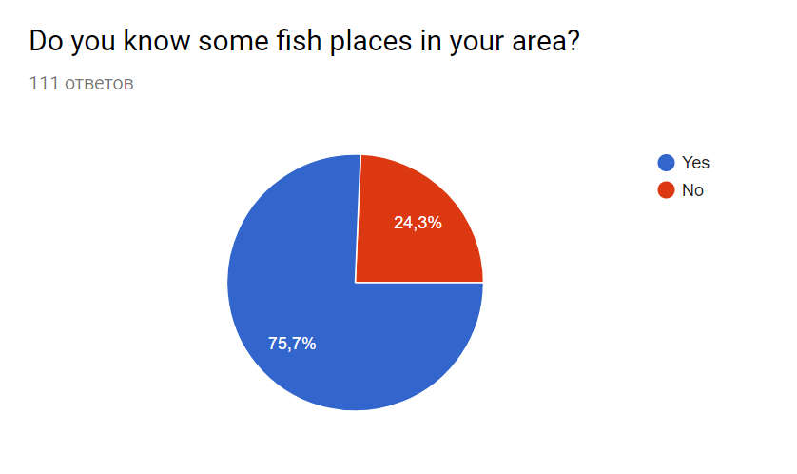
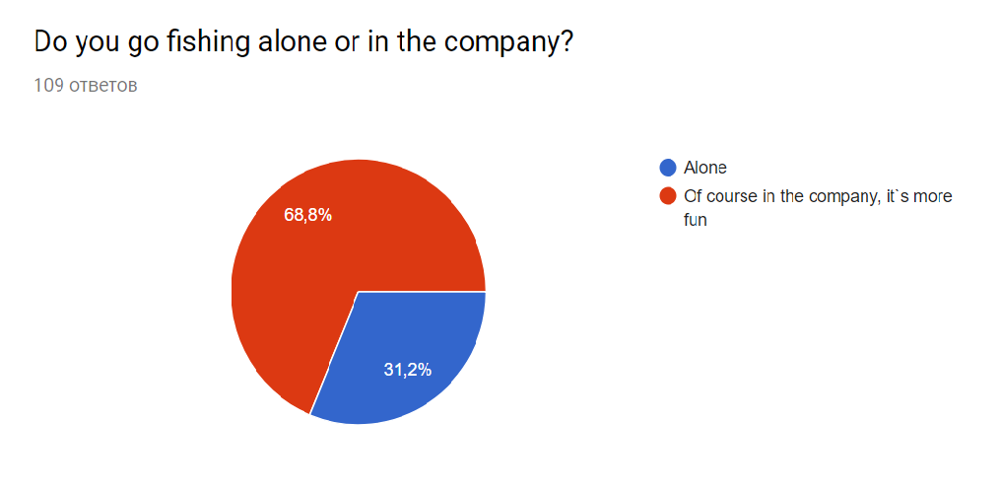
Questionnaire

Slide 20

Interviewing
Interested in a product of this kind to save money and time.
The problem of independent finding of the path and geolocation.
The problem of choosing a store with a wide selection of fishing tackles.
The problem of finding a place for recreation after fishing.

Slide 21
Meeting on requirements
Time | Agenda item | Description
9:00 - 9:30 | Opening | Agenda, organization, rules
9:30 - 10:00 | Discussion of the current state of affairs on the project | Current status of the project, agreements reached, work performed, etc.
10:00 – 11:30 | Presentations | Explanation of the future project concepts
11:30 – 13:00 | Brainstorm | Stage of ideas generation
13:00 – 13:30 | Lunch break | The ability to think over ideas in a different setting
13:30 – 15:00 | Brainstorm | Grouping ideas and prioritizing
15:00 – 15:30 | Outcomes | Summing up, possible minor modifications of the generated functions
15:30 – 16:00 | Completion

Slide 22

Creating Ideas
Automatically update the application once a month
Automatic geolocation detection
Building a path to a fish place

Slide 23
Creating Ideas
Add fish shops to the database
Adding places to rest in the database
The radius of the function of finding fish places

Slide 24
Creating Ideas
Rating system
Expansion of the application to the whole territory of Europe

Slide 25

Clipping Ideas
Expansion of the application to the whole territory of Europe
Automatically update the application once a month
Automatic geolocation detection

Slide 26
Grouping ideas
1
Geography and location
2
Updating application content
3
Optimization and expansion

Slide 27
Prioritization
Priority | Function | Number of votes
1 | The vision of the most popular fishing place in its area | 4
2 | Determining the current location | 4
3 | Route to the fish place | 4
4 | Selecting the range of the program | 4
5 | Possibility to view fish equipment stores and places for rest | 3
6 | Multilanguage | 3
7 | Opportunity to leave comments | 2
8 | Registration via social networks | 2
9 | The cost of booking a fishing place | 2

Slide 28
Storyboard
WHO?
WHAT?
WHEN?
HOW?

Slide 29
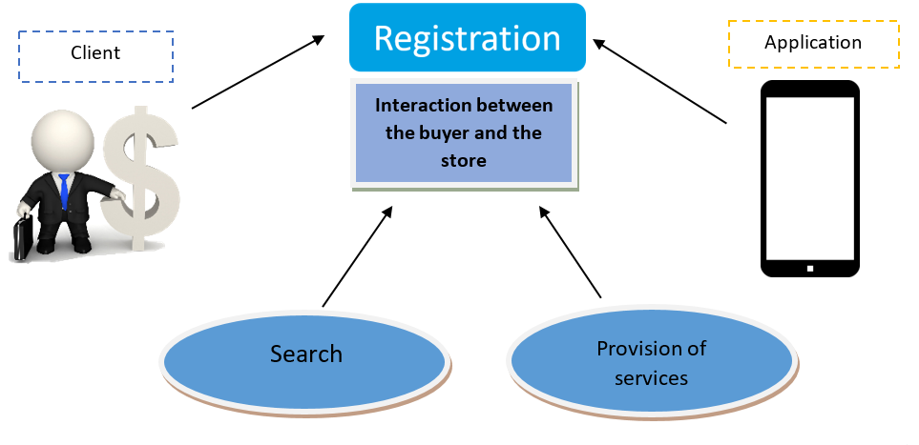
Precedents

Slide 30
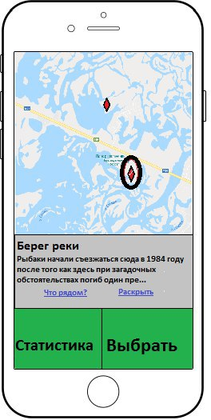
Prototyping

Slide 31

3.System definition
Specification of requirements for subsystems
Vision Document
MRD
Document Delta Vision

Slide 32
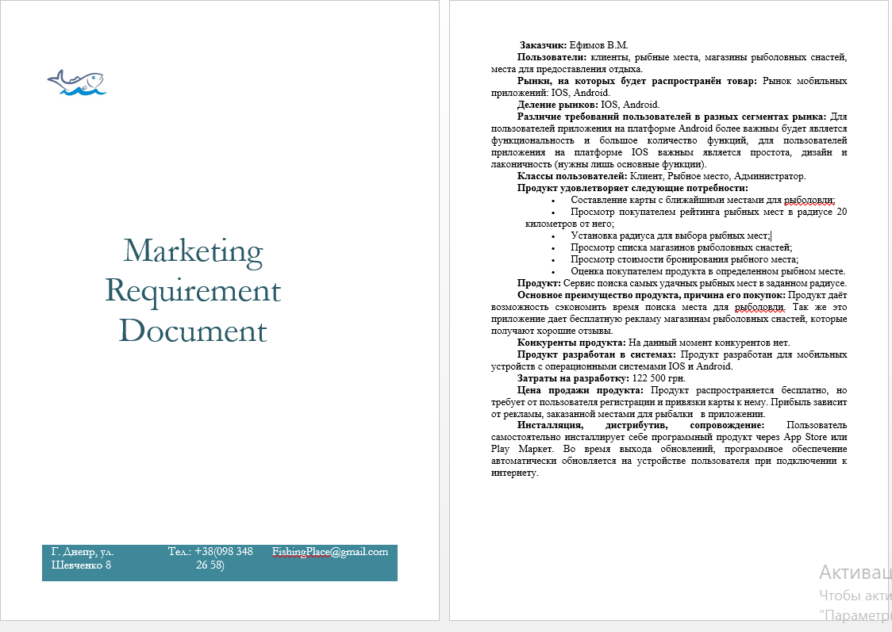
Marketing Requirements Document
It is a document created in order to simplify communication between leadership, service marketing and developer and help in making reasonable business decisions.

Slide 33
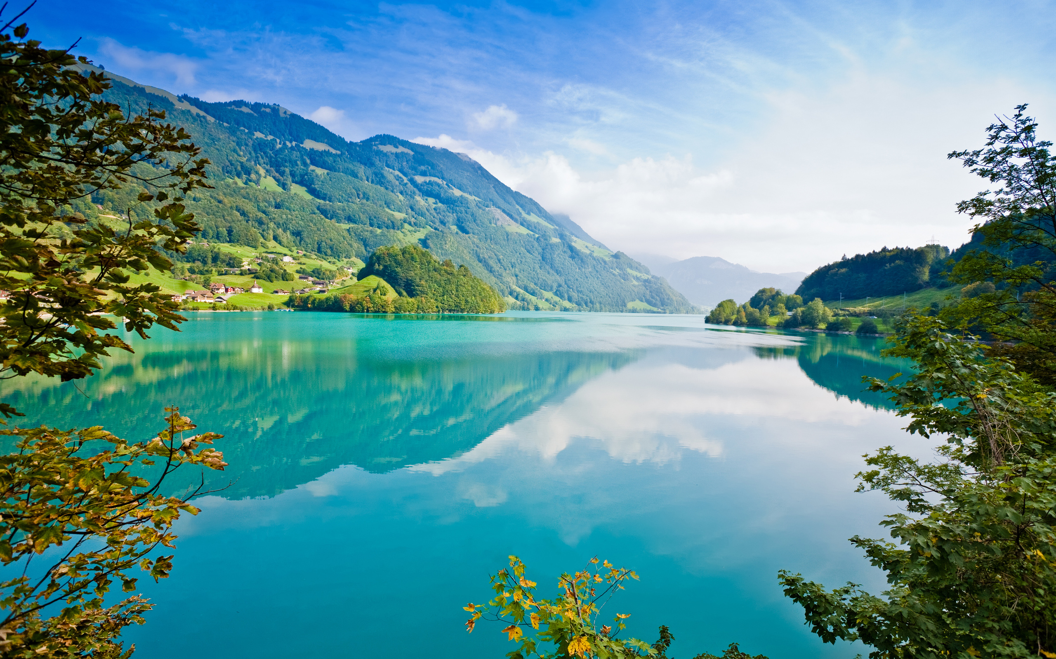

Vision Document
The purpose of creating this mobile application is the need for qualitative products and the solution of the problem of minimizing the time of searching for quality fishing places. The version of the software product at the time of writing the concept document is 1.0.1.
Main users of the system: • Stores products with good reputation and product quality. • A variety of plate-based buyers with a mobile device.

Slide 34
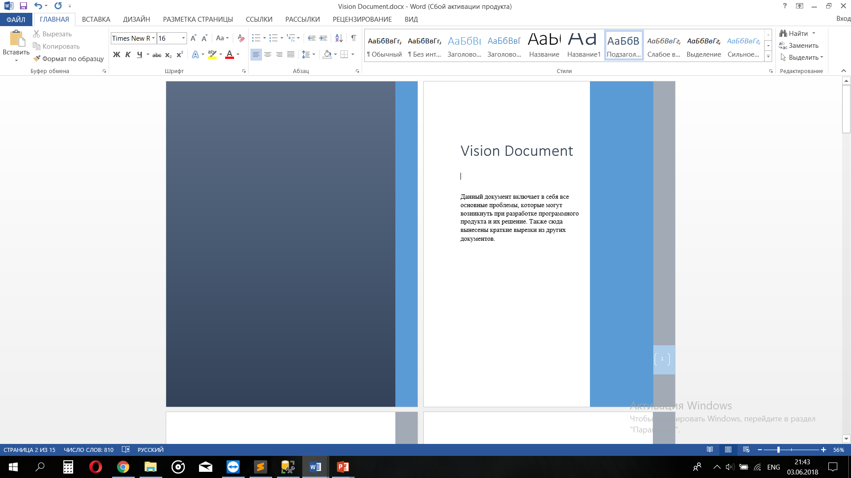
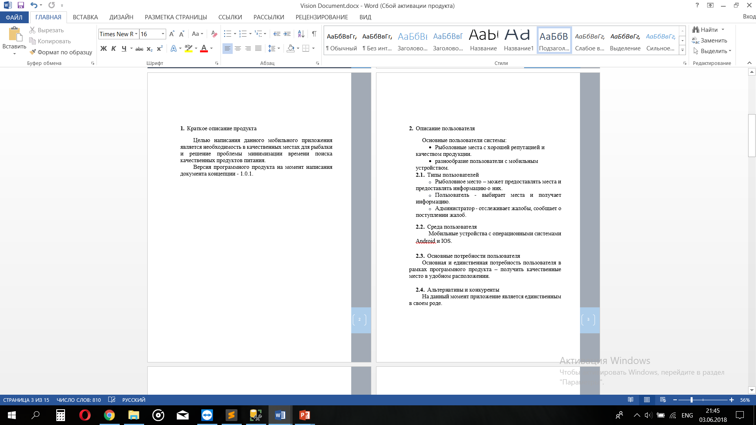
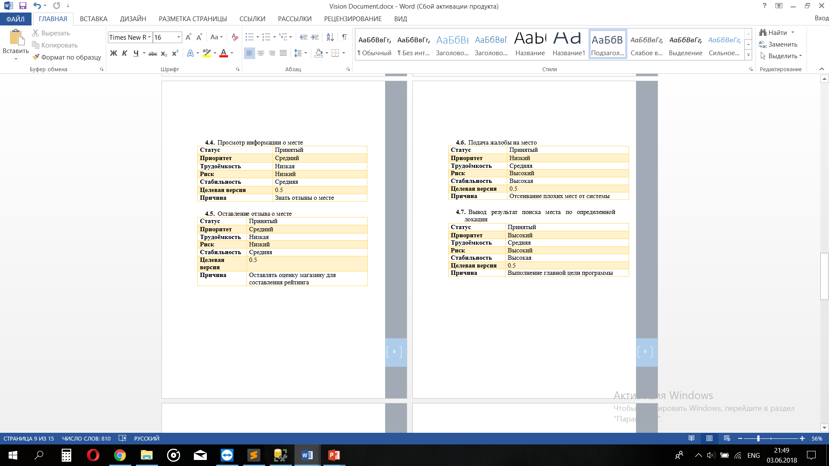
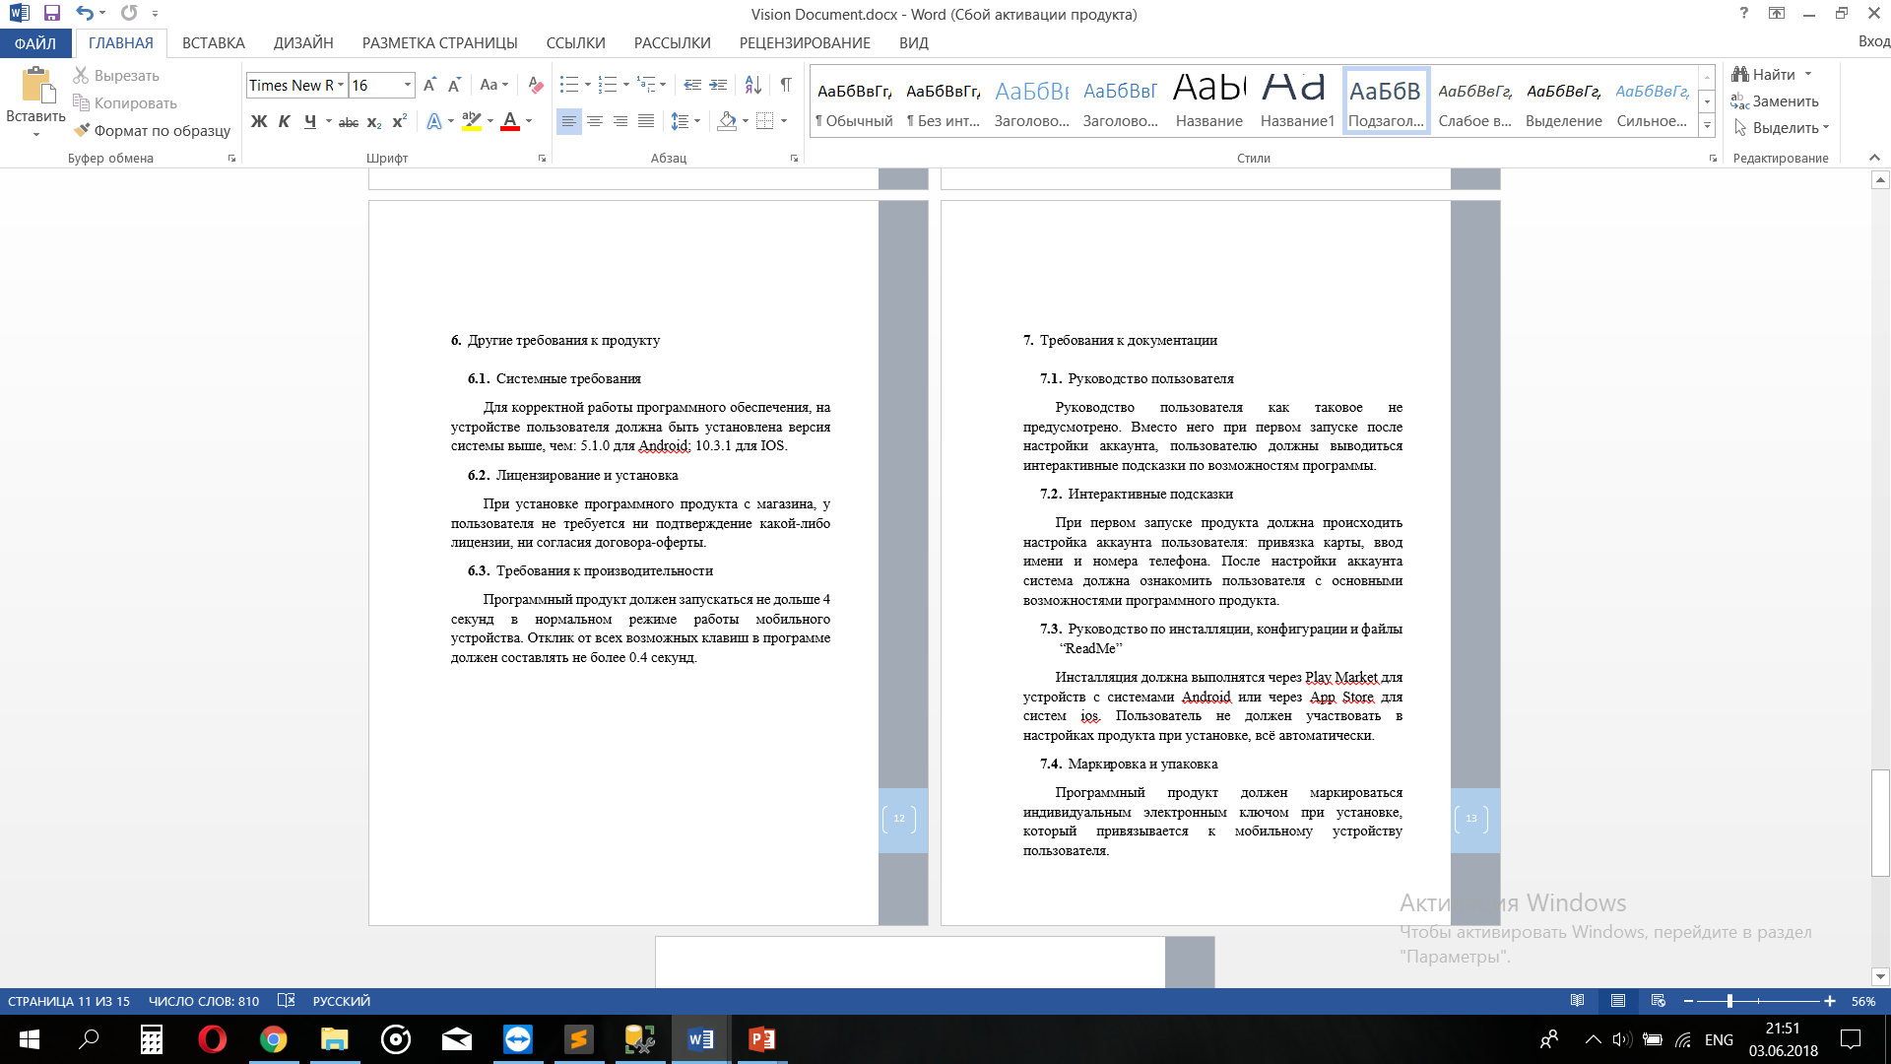
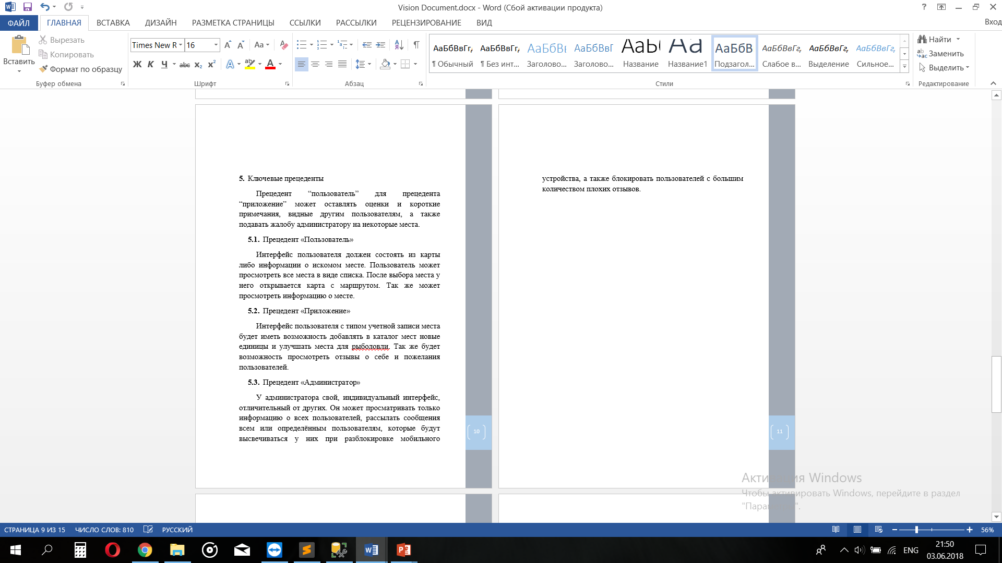
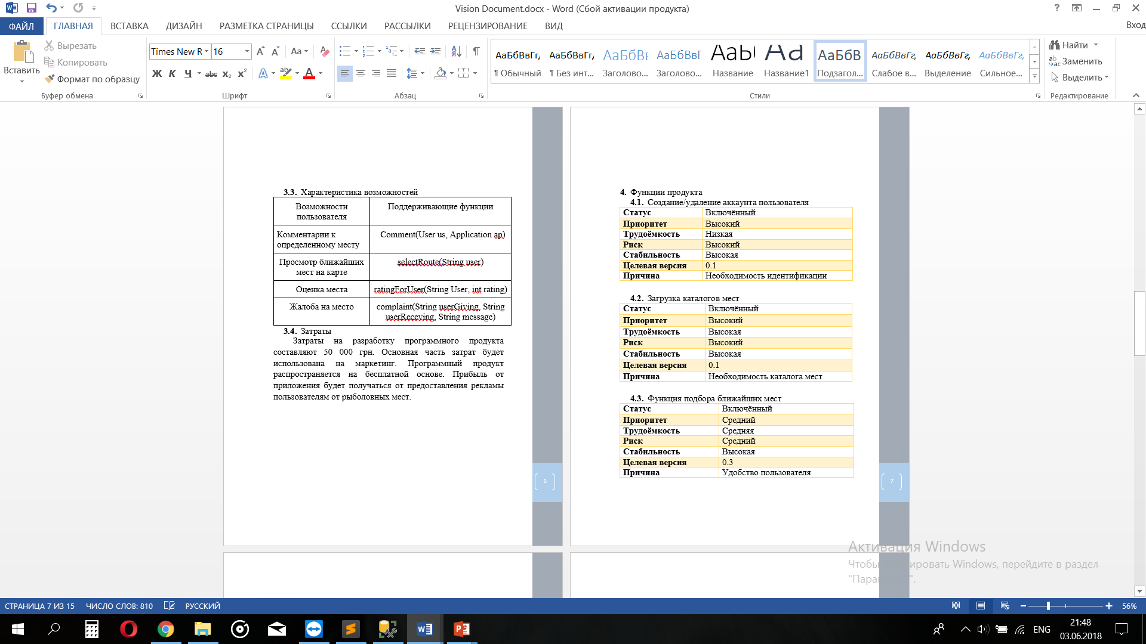
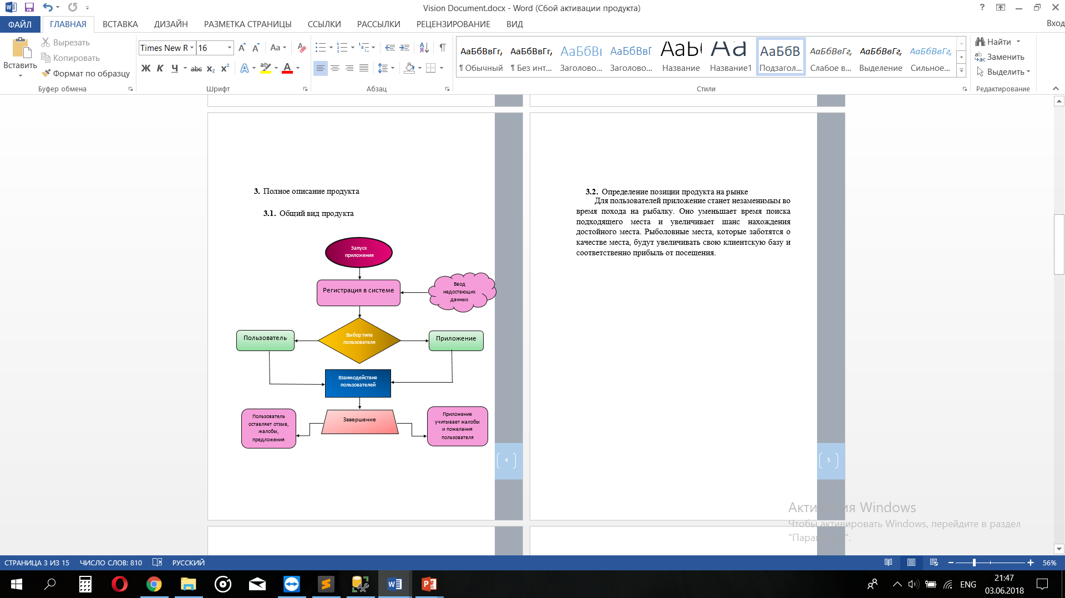
Vision Document

Slide 35
Document Delta Vision
This document includes changes in comparison with the previous version of both the concept document and the software product itself.
It was added features such as the ability to comment on the location, a map with the location of stores, adding a rating for the store. • The version of the software product at the time of writing the concept document is 1.1.0.

Slide 36
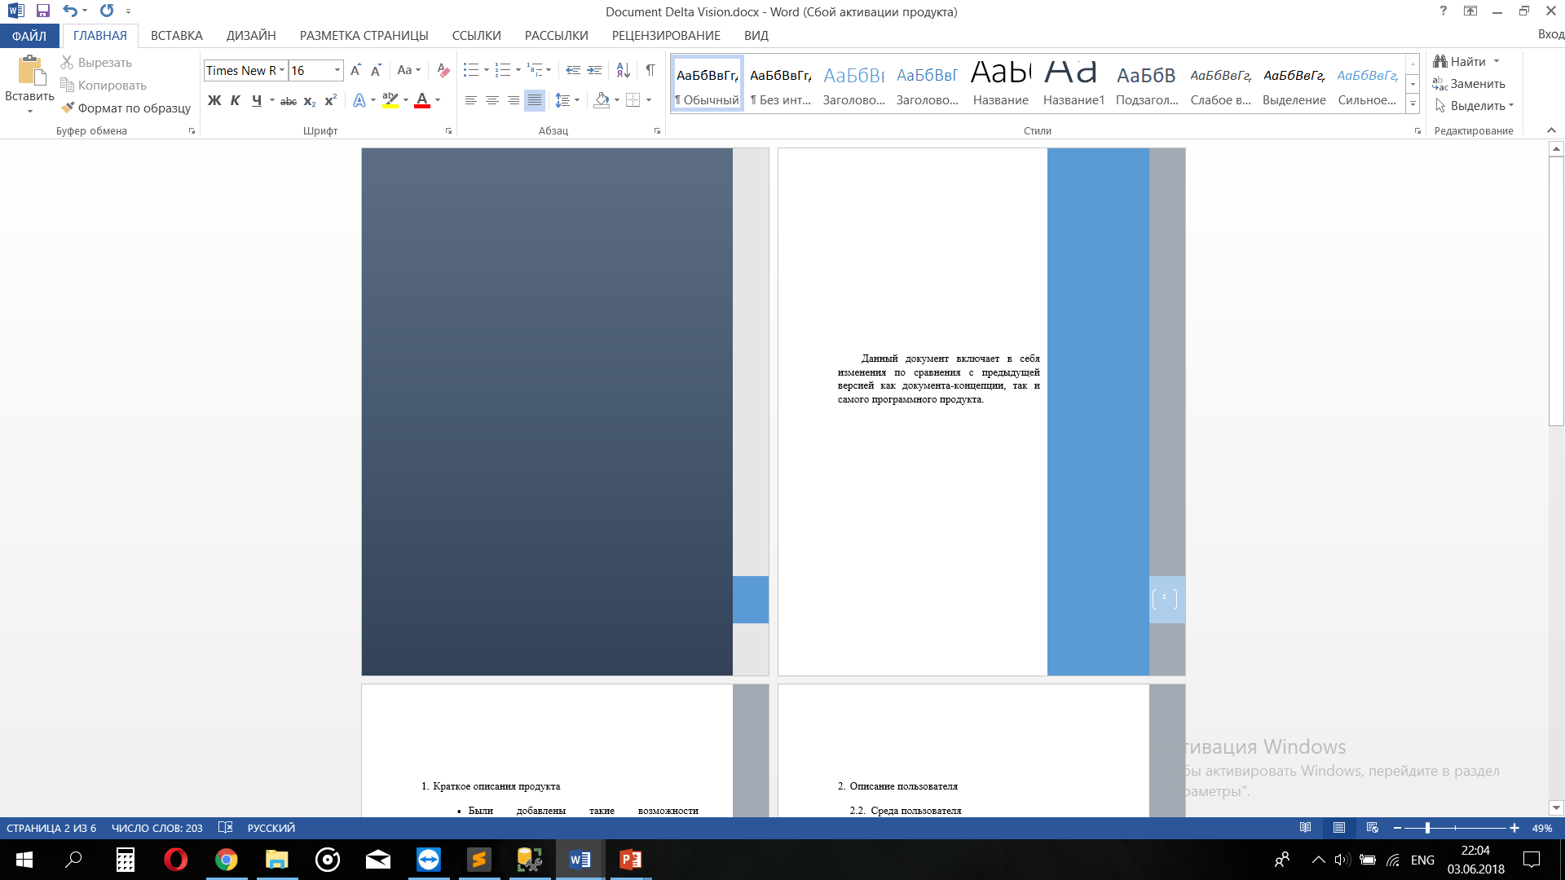
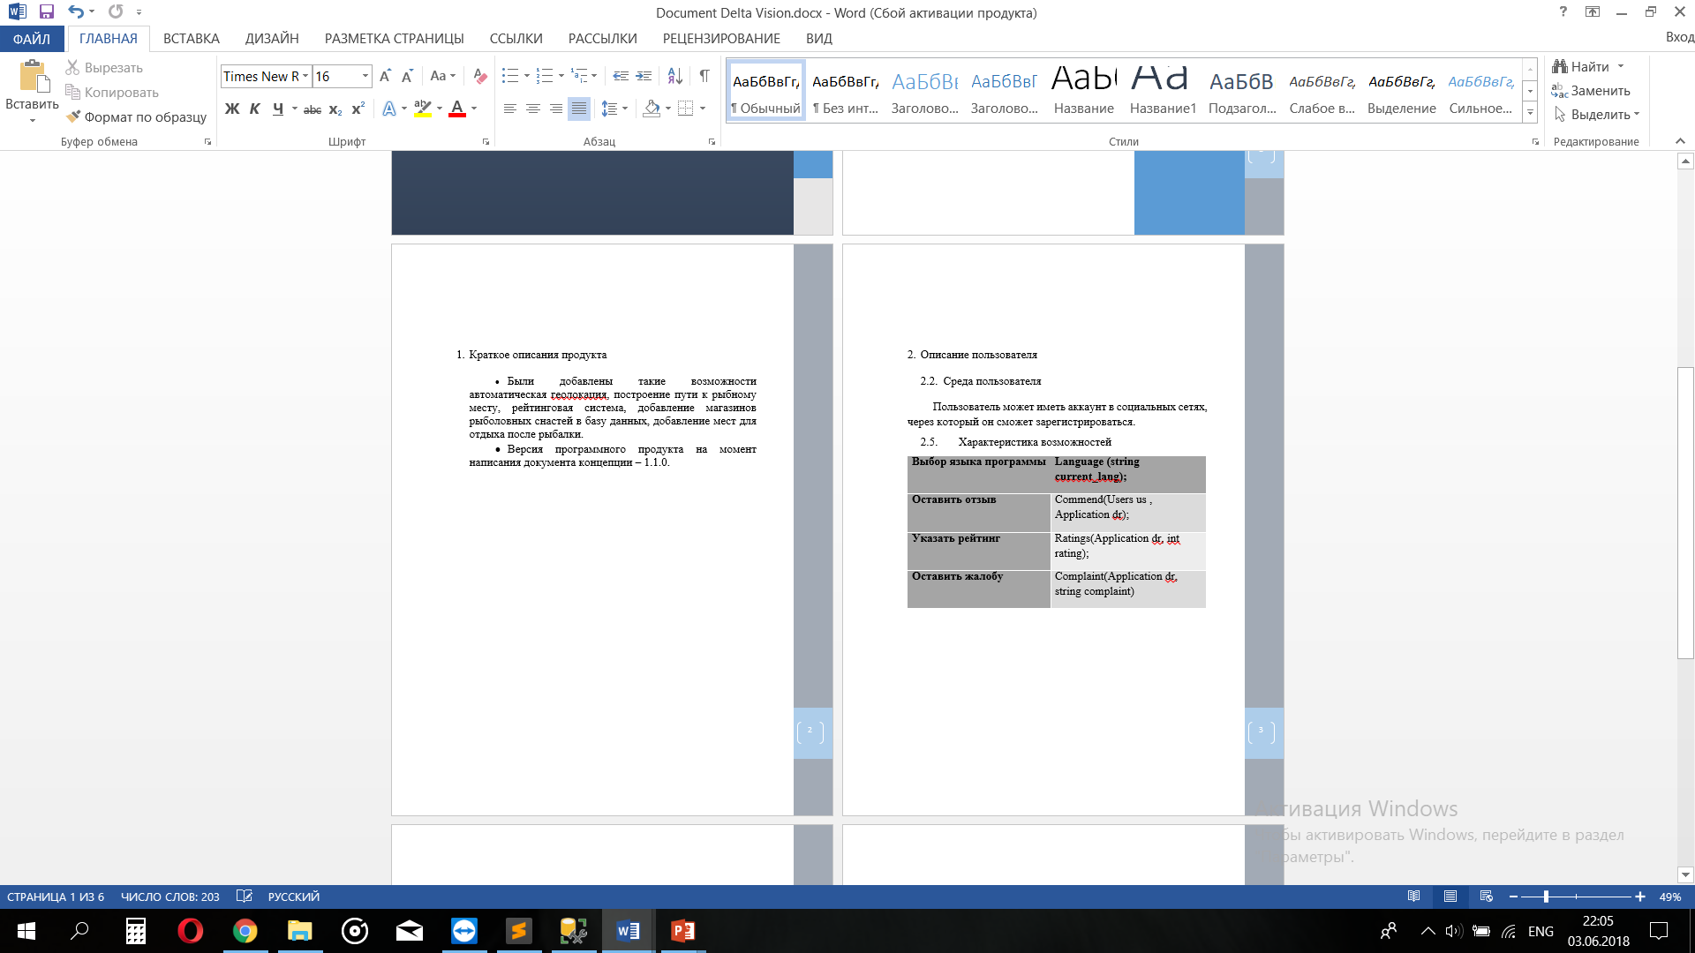
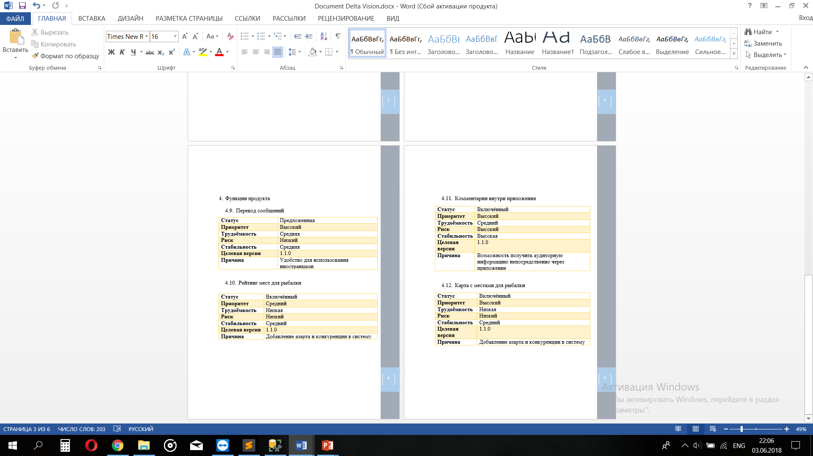
Document Delta Vision

Slide 37
Model of precedent of system level
User
Maps
View the fishing places around buyer
Add a new location
Compare prices
Feedback
Write review
Write commend
Complain
Application
Maps
Add address for fishing places in map
Add a network of fishing tackle stores
Feedback
To connect with users and tell about new good places
Administrator
To consider complaints
Deleting stores with poor rating from catalog

Slide 38


Specification of requirements for the subsystem "Map"
User
Application
Adds to the list of their places during the registration
The map shows the places, which were added by a type of the user “Application" to the card during registering with the service. The user selects the appropriate option from the options offered to him and the application pushes the user the shortest path to the destination.
Chooses the option he needs
The catalog of placed
Map
Adds on the map the address of the fishing places during the registration
Selects the appropriate place on the map
A type of the user “User" selects the places with the help of the search line. The application after the product selection opens the map with a visible radius of 3 kilometers for easy viewing and reading the map.
Route

Slide 39

Specification of requirements for the subsystem “Feedback"
Full
Information about the user
Partial
Reviews
User
Application
Leave a review about the application
Considers
customer reviews
A type of user “Application" only has access to general information. You can leave a response for the one of the fishing places.
Users who registered in the system could write to each other via chat. Also there is an opportunity for the type of user “User" to view the complete information about the type of user “Application".
Complaints
Administrator blocks fish places with very poor reputation
Administrator

Slide 40


4. Scope Management

Slide 41
№ | Function | Priority | Labor intensity | Risk
Basic level
4 | Displaying the most expensive / cheap place in the base of fish places | Critical | Average | Low
6 | Determination of the current location | Critical | Average | Low
9 | Route to the place | Critical | High | Low
7 | Calculating the cost of visiting a place | Critical | Average | Low

Slide 42
№ | Function | Priority | Labor intensity | Risk
Basic level
11 | Preservation of photo barcode locations in the database | High | Low | Low
5 | Multilanguage | High | Low | Low
1 | Ability to evaluate fish places | High | Average | Low

Slide 43
№ | Function | Priority | Labor intensity | Risk
Basic level
2 | Registration via social network | Average | Low | Low
12 | Saving data after an update | Average | Low | Average

Slide 44
№ | Function | Priority | Labor intensity | Risk
Additional level
3 | Selecting the range of the program | Average | Average | Low
10 | Automatic Notifications | Low | Low | Low

Slide 45
Input | Explanation | Output
User location | Required to find spots near the user | Map with surrounding spots
Current location | Required to track the position while en route to the spot | Route to spot
Spot visitation data | To have relevant data | Spot reviews
Spot registration | Administrator can add a new spot | New spot on the map

Slide 46
Building a correct system
Uses DB storage | Data validation | Operation status notification | Facebook authorization
Registration
History of visited spots | Login
 | Account restoration
 | Searching for a spot
 | Selecting a spot
 | Creating a route
Reviewing |  | Reviewing
Information on spots
Data storage | Data storage | Registration confirmation

Slide 47

Email notification | Hashed password | Selecting a spot | Geolocation
Registration | Registration | Searching for a spot | Searching for a spot
Account restoration | Login | Selecting a spot | Selecting a spot
Selecting a spot | Account restoration |  | Creating a route
Reviewing | Registration confirmation
Registration confirmation

Slide 48
Displaying the route | User location as reference point | Change/save settings | Spot rating | Logout
Choosing a spot | Searching for a spot | Searching for a spot | Searching for a spot
Creating a route | Choosing a spot | Creating a route | Choosing a spot
 | Creating a route | Settings | Reviewing
 |  |  | Spot information
 |  |  | Visited spots history | Quitting the app

Slide 49

Thanks For Your Attention

